Slide 1
Our Perpetual Existence
Daniel 2:44 to 1454
See More At http://www.TheRestorationMovement.com/

Slide 2
Nebuchadnezzar's Dream
#
Gentile Kingdom
Image Symbol
Reign over Israel
1
Babylon (a)
Head of GOLD
625 B.C. TO 539 B.C.
2
Medo-Persia (b)
Chest and Arms of SILVER
539 B.C. TO 331 B.C.
3
Greece
Waist and Thighs of BRONZE
331 B.C. TO 164 B.C. (c)
4
Rome
Legs of IRON
164 B.C. - 70 A.D.
Daniel 2:44 - "In The Days Of These Kings . . .
See More At http://www.TheRestorationMovement.com/

Slide 3
⁴⁴“And in the days of these kings the God of heaven will set up a kingdom which shall never be destroyed; and the kingdom shall not be left to other people; it shall break in pieces and consume all these kingdoms, and it shall stand forever. ⁴⁵“Inasmuch as you saw that the stone was cut out of the mountain without hands, and that it broke in pieces the iron, the bronze, the clay, the silver, and the gold—the great God has made known to the king what will come to pass after this. The dream is certain, and its interpretation is sure.” - Daniel 2:44,45 NKJV
See More At http://www.TheRestorationMovement.com/

Slide 4
Jesus Taught:
Mark 9:1 – Some Standing Here Will Not Taste Death Before The Kingdom Comes
Matthew 16:13-19 – “Upon This Rock I Will Build My Church . . . And I Will Give Unto You The Keys Of The Kingdom Of Heaven”
See More At http://www.TheRestorationMovement.com/

Slide 5
On The Day Of Pentecost
Prophecy Fulfilled
vv.16-21 – Joel 2 – God’s Great And Notable Day
vv. 25-28 – Psalm 16:8-11 – David’s Prophecy
Church Starts – v.38-40
Kingdom Rule Begins Thru Apostles’ Binding Authority, cf. v.42-47 with Matthew 16:18,19
See More At http://www.TheRestorationMovement.com/

Slide 6
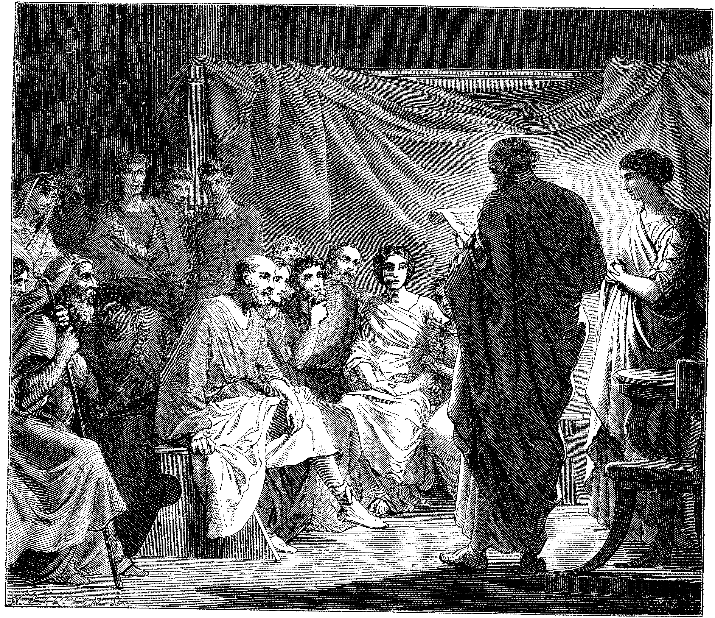
Problems In The Church Required Letters
1 & 2 Corinthians
Disunity Through Partyism
Taking Brothers To Law
Incest
Denial Of The Resurrection, etc.
Colossae – Mysticism, Gnosticism
Revelation – 7 Churches – All With Problems
Acts 20:28ff – Paul’s Warnings
See More At http://www.TheRestorationMovement.com/

Slide 7
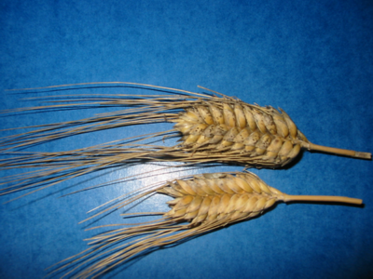
How The Kingdom Prevailed
“But he who received seed on the good ground is he who hears the word and understands it, who indeed bears fruit and produces: some a hundredfold, some sixty, some thirty.”
(Matthew 13:23 NKJV)
Jesus Gave The Seed Principle
Matthew 13
See More At http://www.TheRestorationMovement.com/

Slide 8
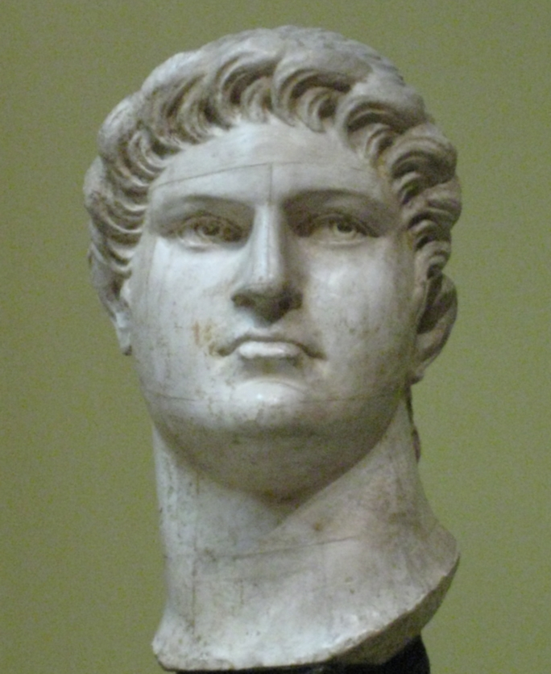
The Turbulent Years Came With Certain Emperors
Nero – 67 A.D.
Domitian – 81 A.D.
Trajan – 108 A.D.
Marcus Aurelius Antonius – 162 A.D.
Severus - 192 A.D.
Maximus – 235 A.D.
Decius – 249 A.D.
Valerian – 257 A.D.
Aurelian - 274 A.D.
Diocletian – 303 A.D.
Graphic source: wikipedia.com
Common Denominator
Act 19:24-28

Slide 9
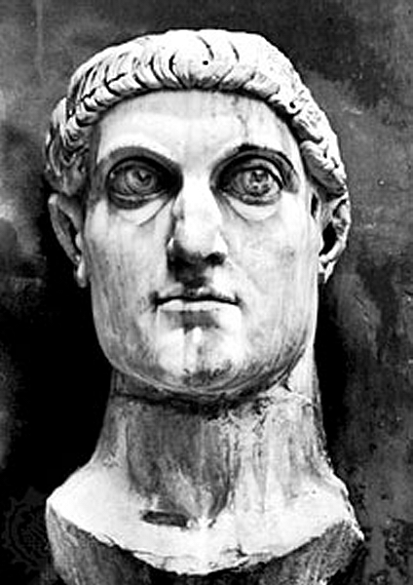
Constantine, The Great
313 A.D. Signed A Law That Christians Would Never Be Persecuted Again By Roman Government
Converted To Christianity On His Deathbed
Made Christianity The State Religion
See More At http://www.TheRestorationMovement.com/

Slide 10
Constantine, The Great
With the rise of Christianity, the pagan religions of the day were enveloped into Christian Tradition
Pagan Temples/Priests Became Christian Temples/Priests
Pagan Religious Days became Christian Religious Days – e.g. Christmas/Easter, etc.
Even “Christian” Days Of The Week Are Of Pagan Origin
See More At http://www.TheRestorationMovement.com/

Slide 11
Roman Church Development
See More At http://www.TheRestorationMovement.com/

Slide 12
Departures
175 A.D. – It Was Written That A Bishop Was Different From An Elder, One Bishop Over Elders
250 A.D. – Development Of One Bishop Over Diocese
407 A.D. – Infant Baptism – Edict of Innocent I
450 A.D. – Spanish churches adding instrumental music
606 A.D. – Boniface III – First Universal Head – Pope
660 A.D. – Pope Vitalian Introduced Organs In The Church
Pope
Cardinals
Archbishops
Bishops
Priests
Deacons
See More At http://www.TheRestorationMovement.com/
Notes:
Roman Catholic Church Hierarchy
The Catholic clergy is organized in a strict, sometimes overlapping hierarchy:
Pope: Head of the church, he is based at the Vatican. The pope is infallible in defining matters of faith and morals.
Cardinal: Appointed by the pope, 178 cardinals worldwide, including 13 in the U.S., make up the College of Cardinals. As a body, it advises the pope and, on his death, elects a new pope.
Archbishop: An archbishop is a bishop of a main or metropolitan diocese, also called an archdiocese. A cardinal can concurrently hold the title. The U.S. has 45 archbishops.
Bishop: A bishop, like a priest, is ordained to this station. He is a teacher of church doctrine, a priest of sacred worship, and a minister of church government. The U.S. has 290 active bishops, 194 head dioceses.
Priest: An ordained minister who can administer most of the sacraments, including the Eucharist, baptism, and marriage. He can be with a particular religious order or committed to serving a congregation.
Deacon: A transitional deacon is a seminarian studying for the priesthood. A permanent deacon can be married and assists a priest by performing some of the sacraments.

Slide 13
After 1000 A.D. – Dark Ages
By 1100 – Papal Customs, e.g. Holy Water Introduced
By 1200 – Baptism By Sprinkling
A Few Years Later, Sprinkling Deceased Infants
A Few Years Later, Prayer Thru Mary
Mary Was Deified In 1967
1290 A.D. – Marinus Sanutus Added Wind Organs Into Churches, - McClintock & Strong v.8, p.739
Only Papacy Had The Bible, No Personal Interpretation Allowed
See More At http://www.TheRestorationMovement.com/

Slide 14
John Cassian (360-435)
See More At http://www.TheRestorationMovement.com/

Slide 15
Paulicians – Late 500s
Persecution of Paulicians
Source: wikipedia.com
See More At http://www.TheRestorationMovement.com/

Slide 16
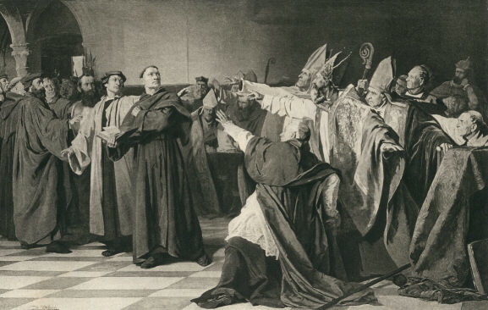
Gundulphus – 1025 A.D.
See More At http://www.TheRestorationMovement.com/

Slide 17
French Leader Pierre de Bruis 1100 AD
Criticized Infant Baptism
Opposed church buildings
Opposed doctrine of transubstantiation
Denied the efficacy of prayers for the dead
See More At http://www.TheRestorationMovement.com/

Slide 18
The Johannes Gutenberg Printing Press - 1454
Arguably History’s Greatest Invention
Produced In Mainz, Germany
First Produced Book: The Bible
See More At http://www.TheRestorationMovement.com/

